Slide 1
Time Series Project “USD/INR Foreign Exchange Rates” Analysis Presentation

Slide 2
Project analysis slide 2
In this project, We are going to forecast or predict the future values of USD against INR using historic data for upcoming 30 years.
IMPLEMENTED
using ARIMA MODEL
ANALYSIS
Time Series Analysis
PROJECT
TESTING
Validation of model
DEVELOPED BY-
Rajat Bhardwaj
HMR institute of Technology & Management

Slide 3
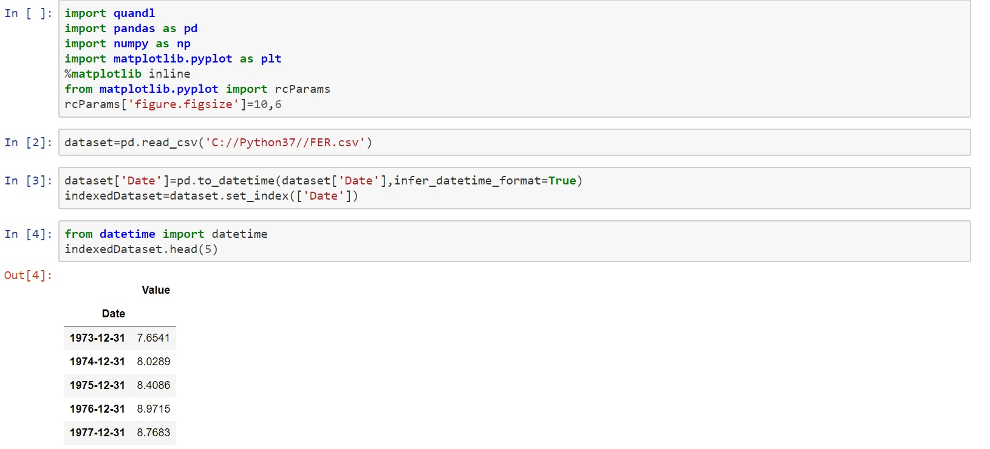
So here all the necessary libraries are imported like pandas for visualization and data analysis and I have just defined a size using rcParams. Then I have imported a dataset of USD/INR from Quandl and displayed only top 5 Values of the dataset.
So that our graphs remain inside the Jupyter notebook only, it will not open in new window
Parse strings to datetime format
Here you have index variable as month

Slide 4
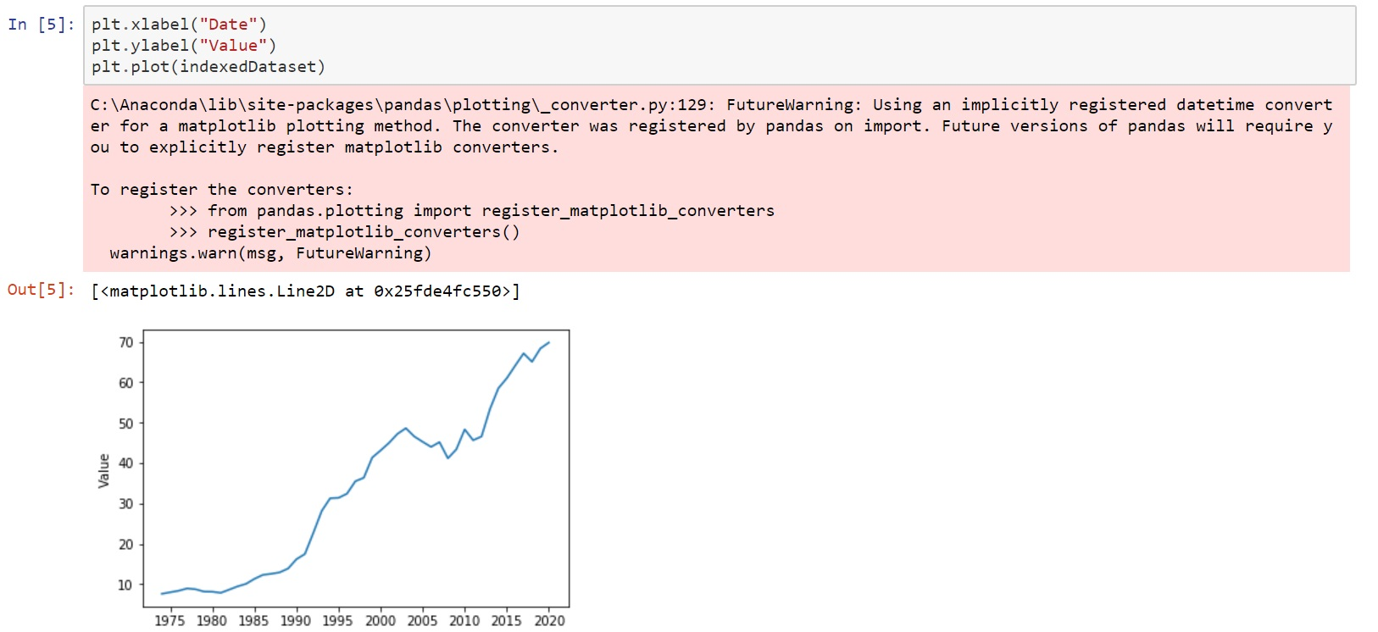
Now I have just plotted a graph between the Date and Value of the dataset.

Slide 5
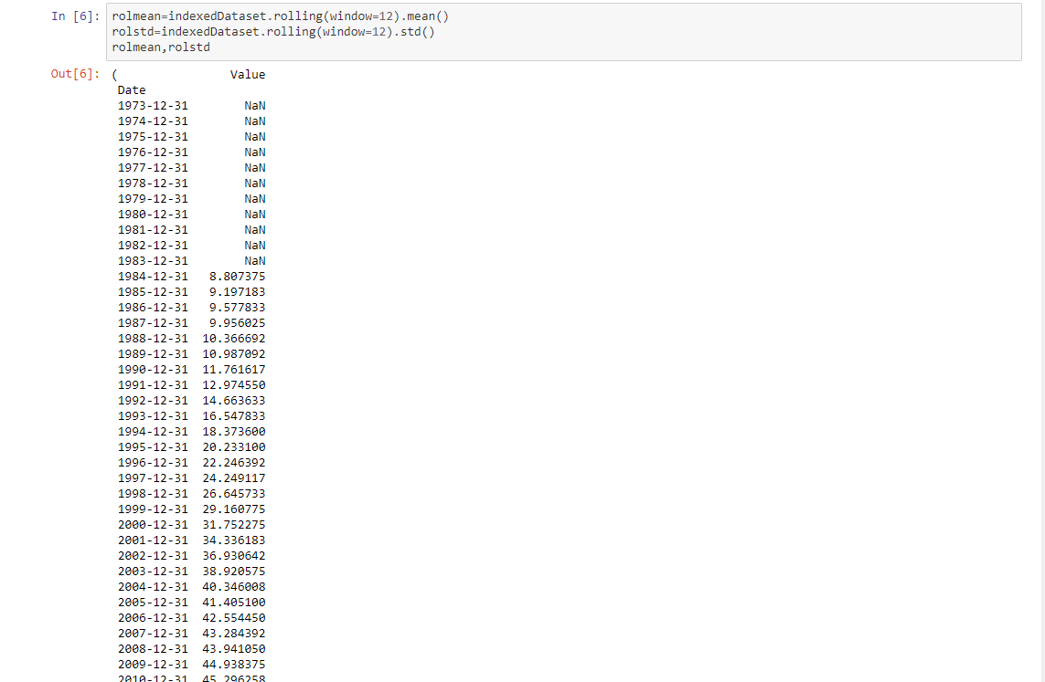
So here I am using two important tests that will check the stationarity of the data. One of them is Rolling statistics. In rolling statistics, window is taken as 12 it means window of 12 months is taken therefore the first 12 values of the data are used to calculate the mean and standard deviation

Slide 6
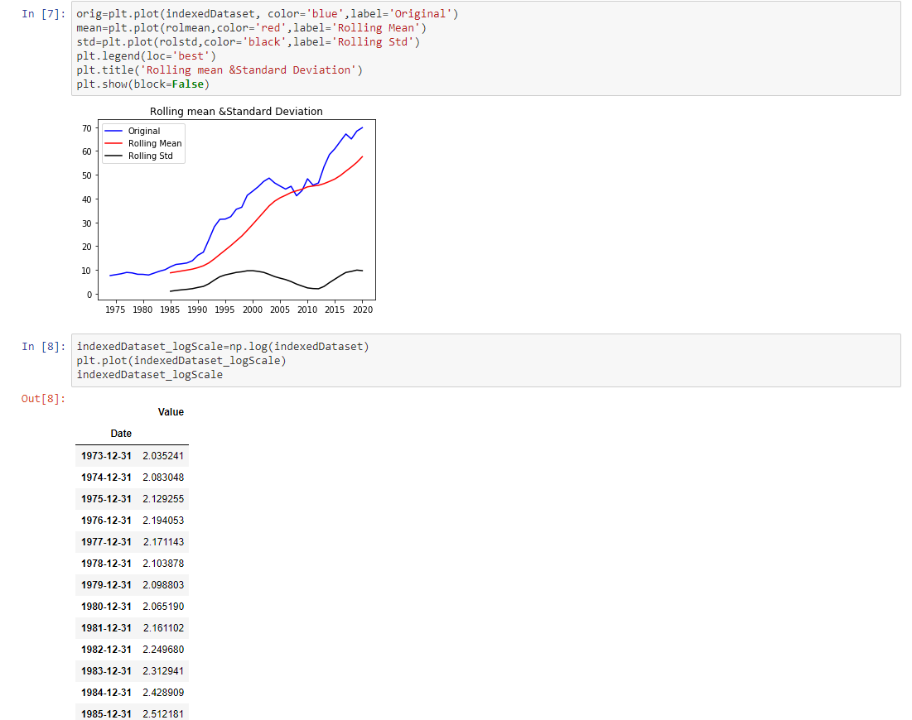
So here I have simply plotted a graph between my original data, rolling mean and rolling standard deviation. Here by watching this graph we can conclude that our rolling mean and standard deviation is not constant. Hence our data is not stationary.
Here I have used np.log function to find out the logarithmic value of the original data and plotted a graph between date (index) and logarithmic values

Slide 7
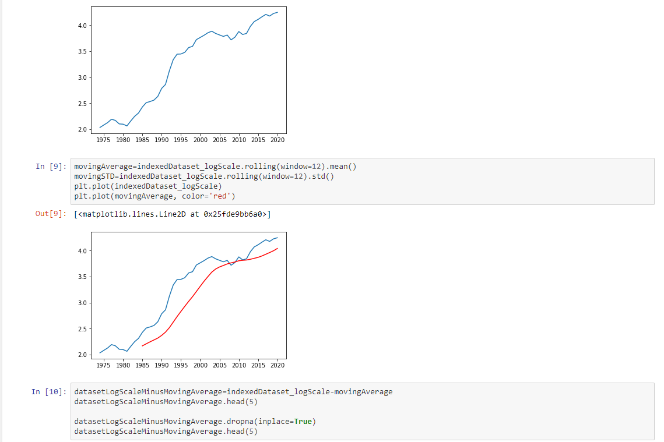
Now I have find out the rolling mean and rolling standard deviation of the logarithmic values and plotted a graph between the log values and moving average(rolling mean of log values). From this graph we can conclude this our mean is not stationary but it is quite better than the previous one
Graph of the previous slide
To make my data stationary I have subtracted the log values from moving average. And unless you do not perform such transformations
You will not get your data as stationary
Graph between log values and moving average

Slide 8
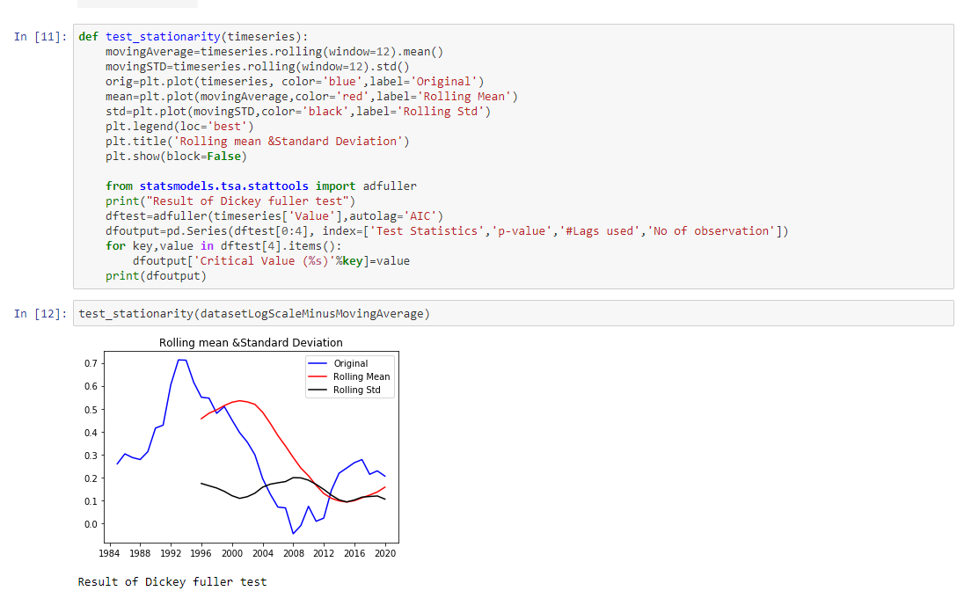
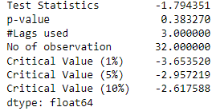
So here I have made a function having name “test_stationarity” which will test the stationarity of the time series. In this function, both tests are present (1)- Rolling statistics (2)- Augmented Dickey Fuller test
Rolling statistics test
Plotting graph between Rolling mean & Standard deviation and original data
Augmented Dickey fuller test
This is the graph of datasetLogScaleMinusMovingAverage
And it is better than the previous graphs because it’s mean and standard deviation curves are more constant than previous ones
Look here the p value is 0.38 which is greater than 0.05. Hence we can conclude our data is not stationary yet

Slide 9
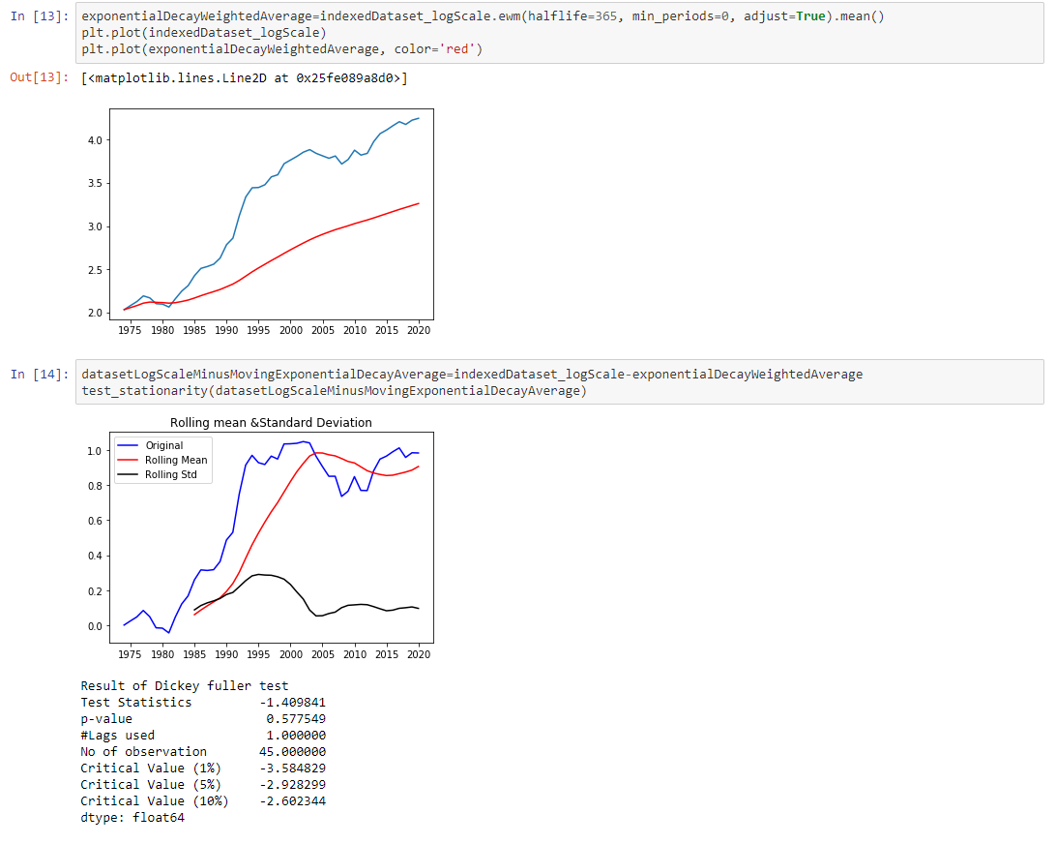
Now here I have calculated the weighted average of timeseries to see the trend inside the timeseries
Here we can see that our mean is progressive with the trend and keeps on increasing with time
So here is the another transformation in which we have subtracted the weighted mean from log Scale while in previous transformations we have subtracted the normal mean
So here we can see our data is not stationary still yet

Slide 10
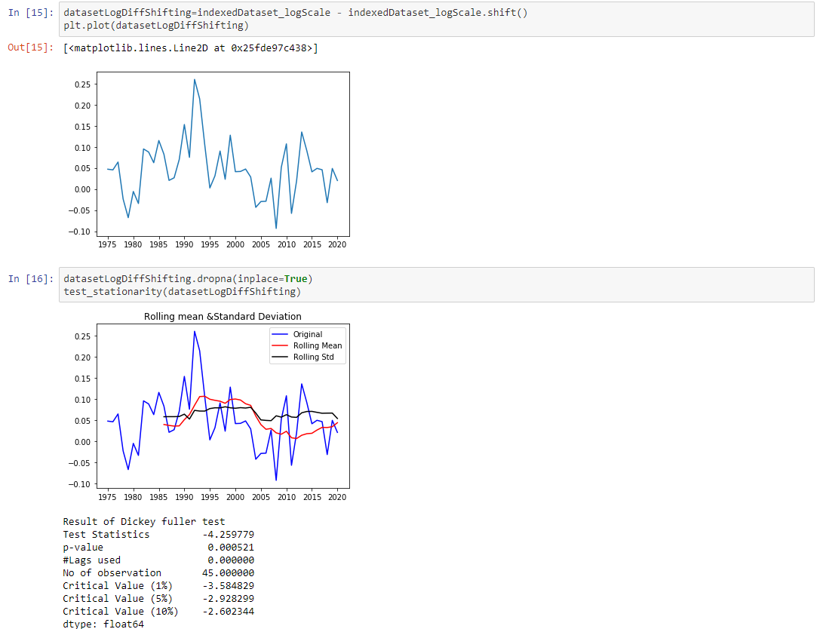
Earlier, We have subtracted the mean from the actual value, Now we will use a function shift() to shift all those values by a lag (or difference) of 1
So the lag or difference is known as d-parameter or integration parameter which tells us how many times you have differentiate the timeseries
Here we have removed all the NaN values from the shifted data and then checked for stationarity of shifted data
As we can see here, Our p-value is less than 0.05 it means now our data is stationary therefore we can reject null hypothesis now

Slide 11
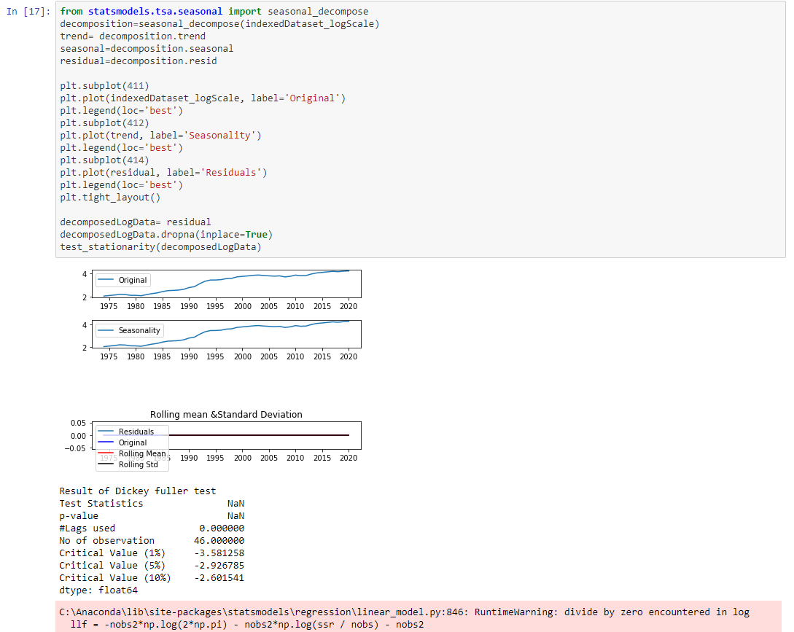
Now we see the components of timeseries
Import the library seasonal_decompose
Which will segregate three components- trend, seasonal and residual
And now we have simply plotted the graph between these three components

Slide 12
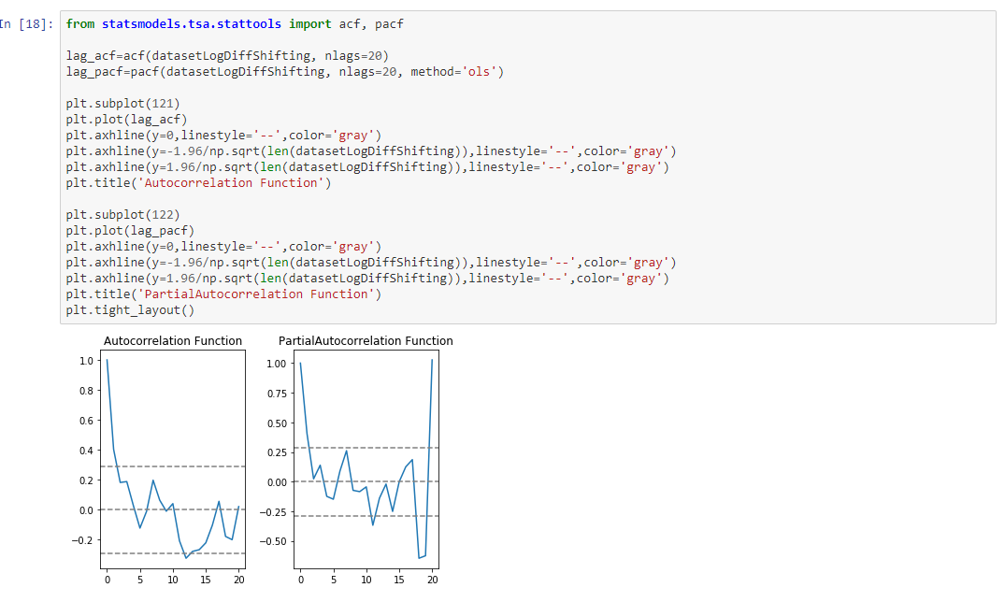
To plot the ACF (Autocorrelation Function) and PACF (Partial Autocorrelation Function) we need to import acf and pacf libraries
ACF is used to calculate the q parameter and PACF is used to calculate the p parameter
We have created acf and pacf of our stationary dataset
Ordinary least square method is used here
We have simply plotted ACF graph
We have simply plotted PACF graph
Here we can see the ACF and PACF curves cut the confidence level at 2 on the x axis so the value of p and q parameter will be 2

Slide 13
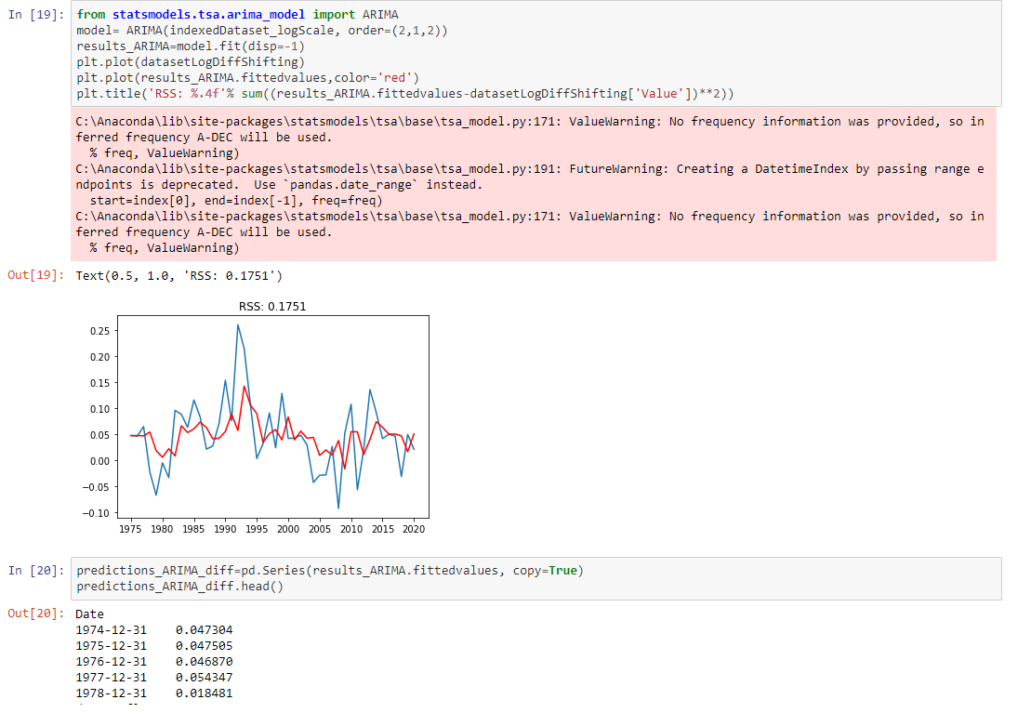
We have just imported ARIMA model to predict the future values
Here I have taken p=2, d=1 and q=2 on the basis of my previous calculations
Plotted the graph of the fitted values in ARIMA model
The less your RSS value the more good your model is
Here we have just converted the fitted values into the series format

Slide 14
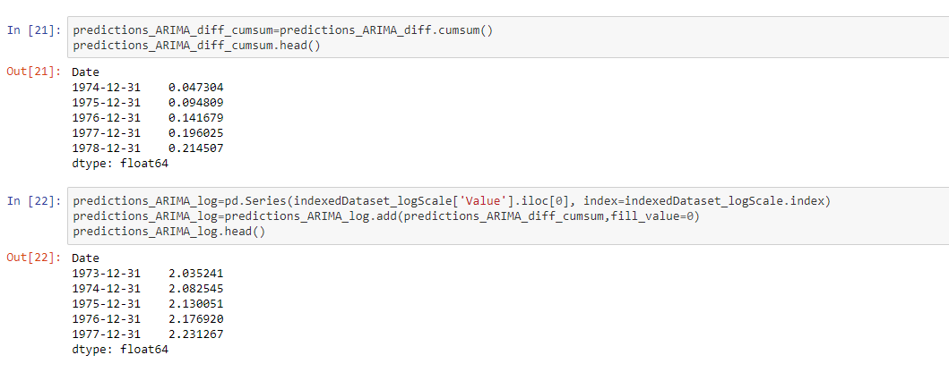
Now here we have just calculated the cumulative sum and to do that we have used a function cumsum() and then printed the head of it. After that we will have the predictions done for the fitted values and printed head of it.

Slide 15
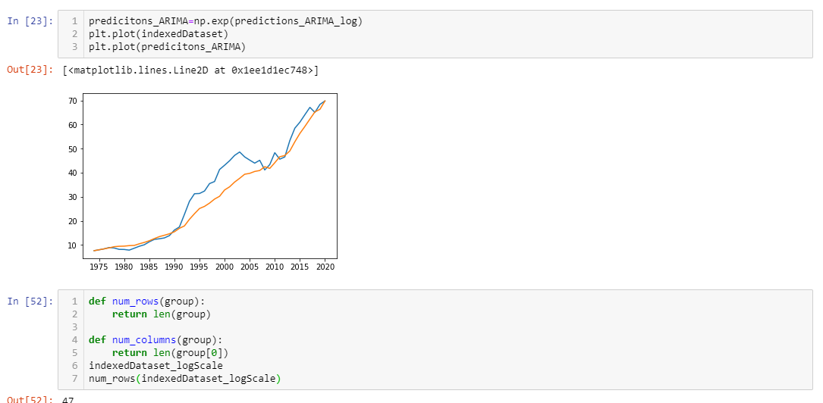
So here we have transformed the data back to its original form by using exponent function of numpy.
Here Blue curve is our original data and Orange curve is our ARIMA model’s predictions
Here I have just calculated the no. of rows and columns

Slide 16
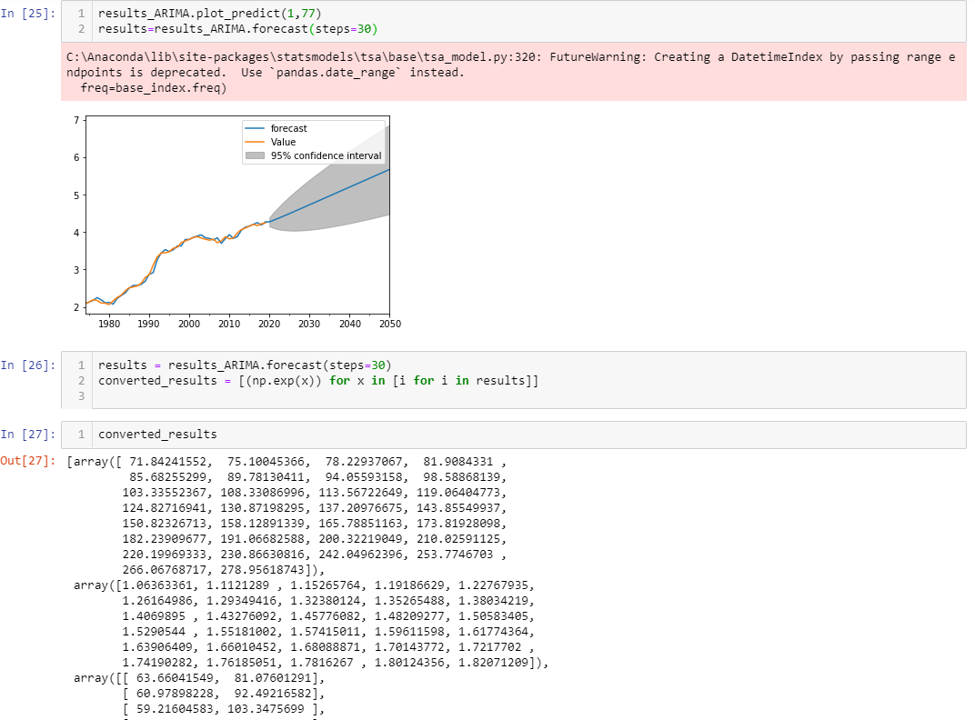
So finally ARIMA model will predict and forecast the values for next 30 years
Transforming the forecasted values back from the log values into the original form
This is the final result. Future predicted values of USD/INR for upcoming 30 years.

Slide 17
Thank You Developed by- Rajat Bhardwaj Phone no-(+91)9990575718 Email-rajat.bhardwaj2000@gmail.com

